Slide 1


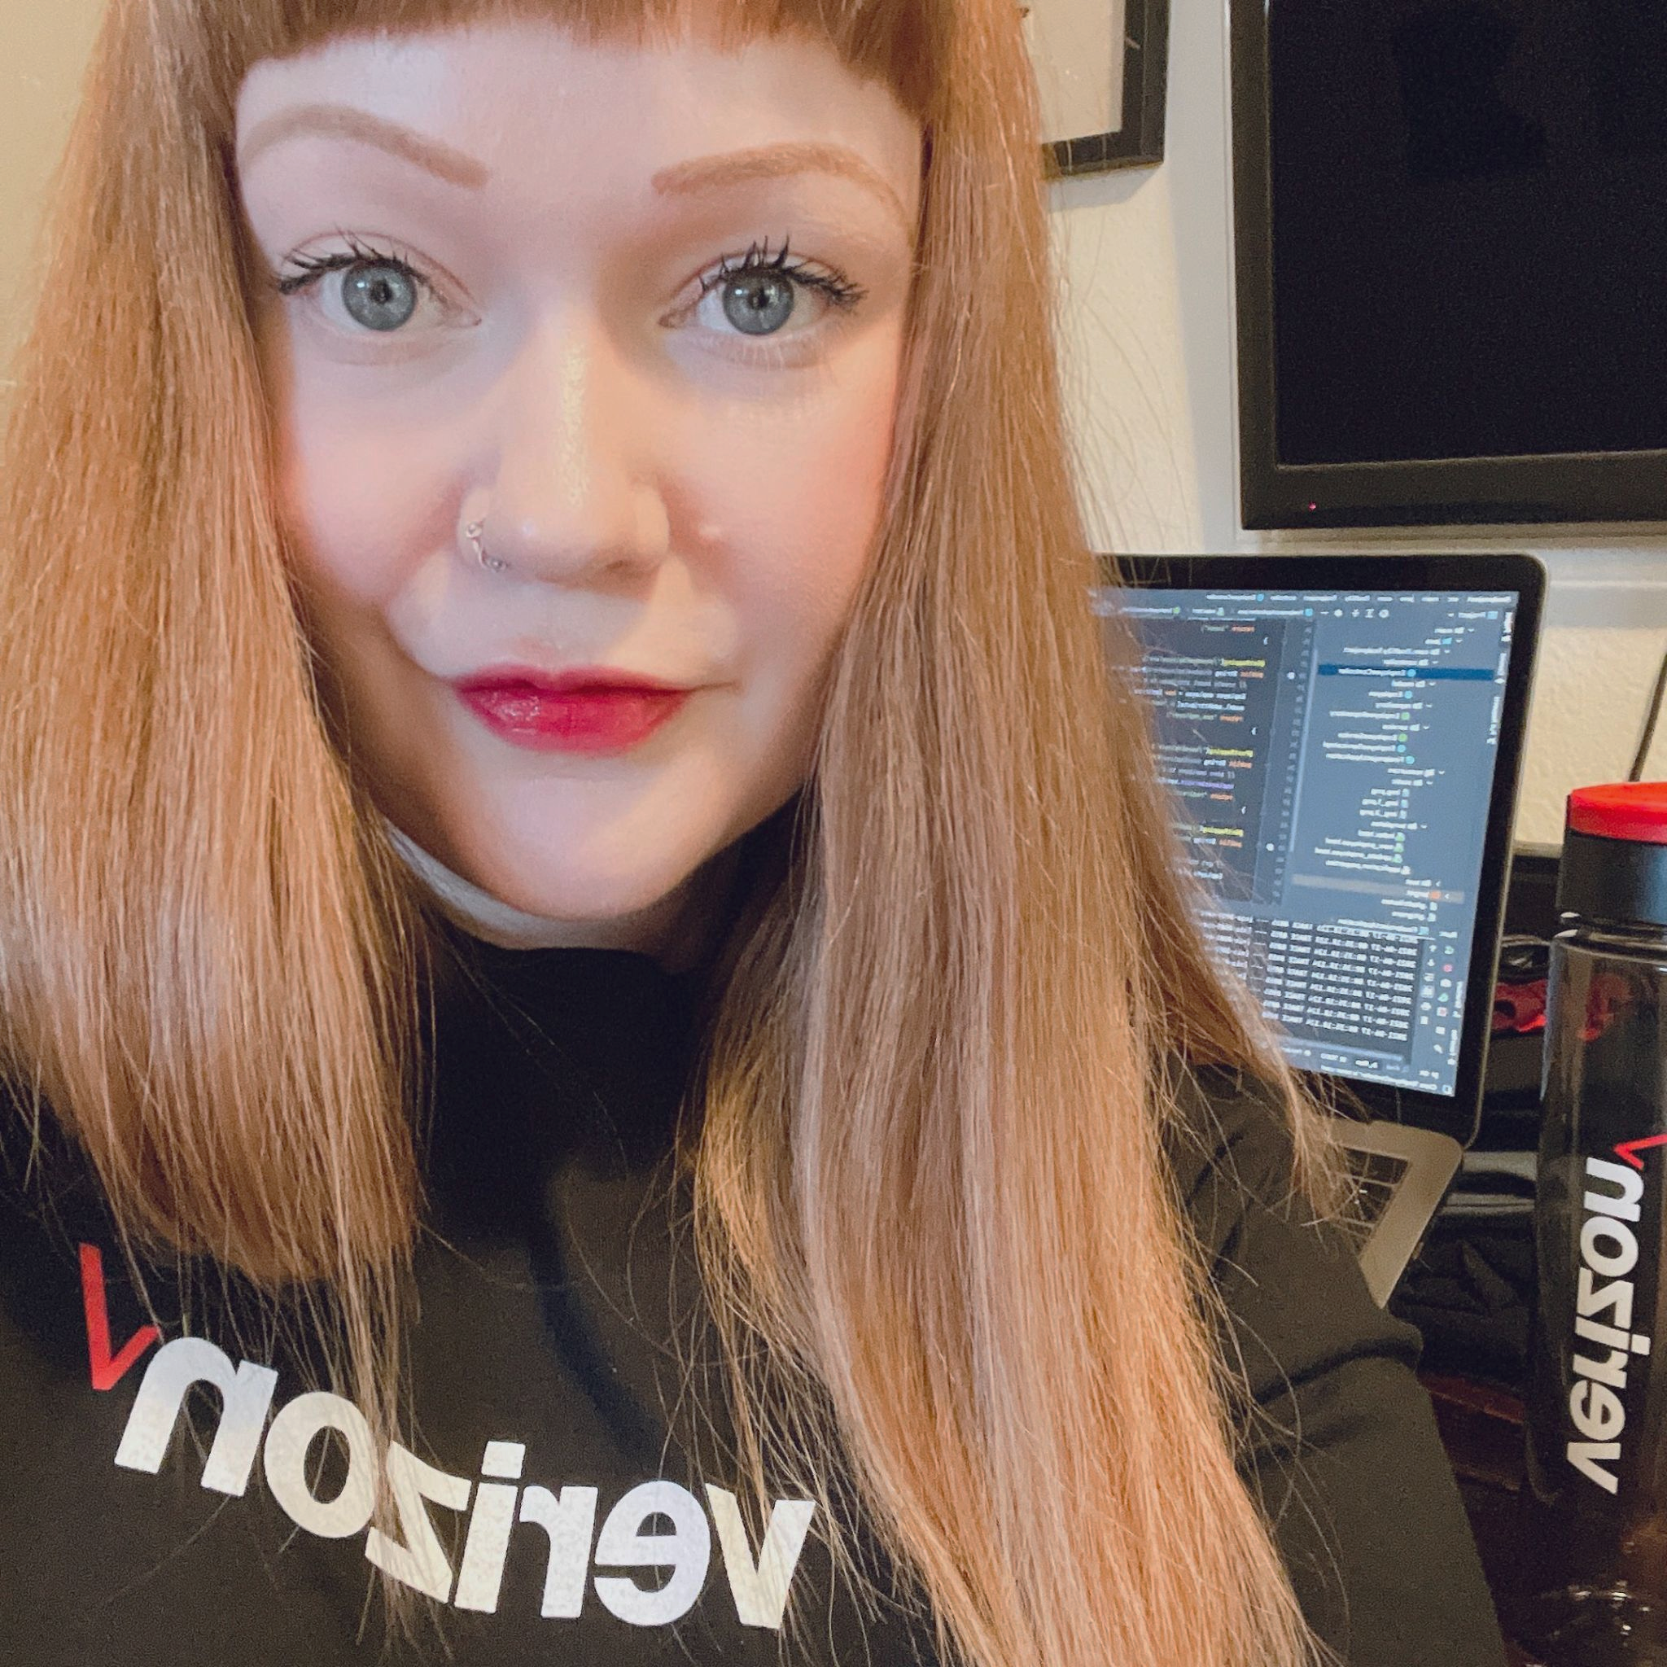

Lindsey’s Apprenticeship Progress
Lindsey Trujillo ✦ Verizon Apprentice Software Engineer
June 2021 — June 2022

Slide 2

Learnings 🪴
Multiverse: Javascript, TDD, SQL, Sequelize, Express, Agile, Responsive Design, React.js, A11Y, RESTful design patterns, Server-Side rendering, The DOM, Auth (Basic Auth & OAuth), JWTs, SDLC, Docker, GitHub Actions, OWASP
Verizon: Earned Tosca (test automation program) certifications levels 1 & 2, used Jira and qTest as a member of an Agile QA (quality assurance) testing team conducting E2E manual testing of Verizon.com, participating in daily stand-ups, grooming calls, and retrospectives as part of 2 week sprints with my team
Independently: Due to my personal interest in the field, I completed a couple of UX Research courses on Pluralsight & observed some rapid research sessions at Verizon. I completed a Java course on Treehouse, used Vue.js and Java for my final independent project, and am currently working towards an AWS certification

Slide 3
Personal takeaways 🌳
Throughout the apprenticeship I learned the value and necessity of being your own advocate and consistently asking questions - in a working environment where everyone is very busy with their own work, and that is mostly remote, it can be challenging to receive the answers you need in a timely fashion while trying to learn and work, so advocating for myself became crucial to my success
Verizon’s adoption of Agile methodology is still new (not all teams use it, but mine does) and as a result, has been a learning experience for myself and even seasoned Verizon employees - I’ve learned a lot about Agile through observing/participating in meetings such as the daily stand-ups, user story grooming calls, technical discussions, retrospectives, etc.
Both in Multiverse projects and my work with Verizon I’ve gained more confidence in my ability to troubleshoot and do research for solutions to any blockers I may face
Through my work with Multiverse/Verizon I’ve been able to better determine my own interests and future career goals

